Slide 3
OVERVIEW
Segmentation Dataset
Spambase Dataset
Credit Card Fraud Dataset
Imbalanced Ratio
1 : 6
Imbalanced Ratio
2 : 3
Imbalanced Ratio
1 : 57
Attributes
20
Attributes
58
Attributes
30
Observations
2308
Observations
4601
Observations
284807

Slide 4
OVERVIEW
Segmentation Dataset
Spambase Dataset
Imbalanced Ratio
1 : 6
short-line-density-2
0
0
0
0
…
0
short-line-density-5
0
0
0
0
…
0
region_pixel_count
9
9
9
9
…
9
… | X20
… | …
… | …
… | …
… | …
… | …
… | …
Attributes
20
Observations
2308
Spambase Dataset
Credit Card Fraud Dataset
Imbalanced Ratio
2 : 3
Imbalanced Ratio
1 : 57
Attributes
58
Attributes
30
Observations
4601
Observations
284807

Slide 5
OVERVIEW
Segmentation Dataset
Imbalanced Ratio
1 : 6
short-line-density-2
0
0
0
0
…
0
short-line-density-5
0
0
0
0
…
0
region_pixel_count
9
9
9
9
…
9
… | X20
… | …
… | …
… | …
… | …
… | …
… | …
Attributes
20
Observations
2308
Spambase Dataset
Credit Card Fraud Dataset
Imbalanced Ratio
2 : 3
Imbalanced Ratio
1 : 57
Attributes
58
Attributes
30
Observations
4601
Observations
284807

Slide 6
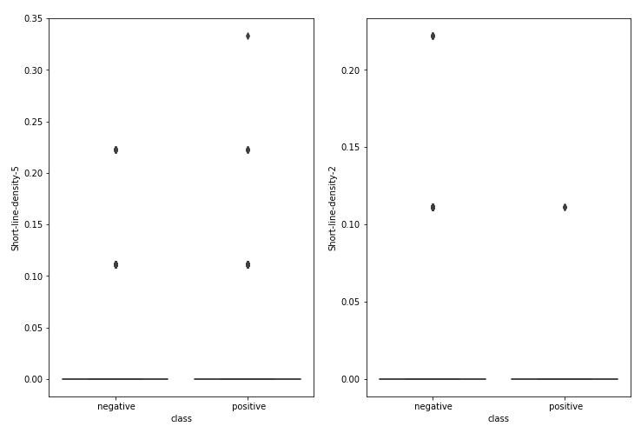
OVERVIEW
Segmentation Dataset
short-line-density-5
short-line-density-2
Imbalanced Ratio
1 : 6
short-line-density-2
0
0
0
0
…
0
short-line-density-5
0
0
0
0
…
0
… | X20
… | …
… | …
… | …
… | …
… | …
… | …
Attributes
19
Observations
2308
Spambase Dataset
Credit Card Fraud Dataset
Imbalanced Ratio
2 : 3
Imbalanced Ratio
1 : 57
Attributes
58
Attributes
30
Observations
4601
Observations
284807

Slide 7
OVERVIEW
Segmentation Dataset
Imbalanced Ratio
1 : 6
Attributes
17
Observations
2308
Spambase Dataset
Credit Card Fraud Dataset
Imbalanced Ratio
2 : 3
Imbalanced Ratio
1 : 57
Attributes
58
Attributes
30
Observations
4601
Observations
284807

Slide 8
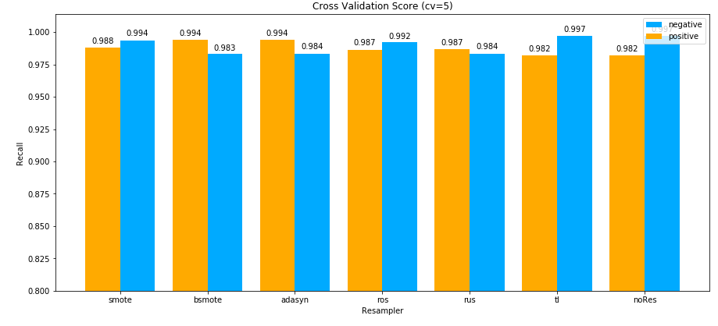
OVERVIEW
Segmentation Dataset
Imbalanced Ratio
1 : 6
Attributes
17
Observations
2308
Spambase Dataset
Credit Card Fraud Dataset
Imbalanced Ratio
2 : 3
Imbalanced Ratio
1 : 57
Attributes
58
Attributes
30
Observations
4601
Observations
284807

Slide 9
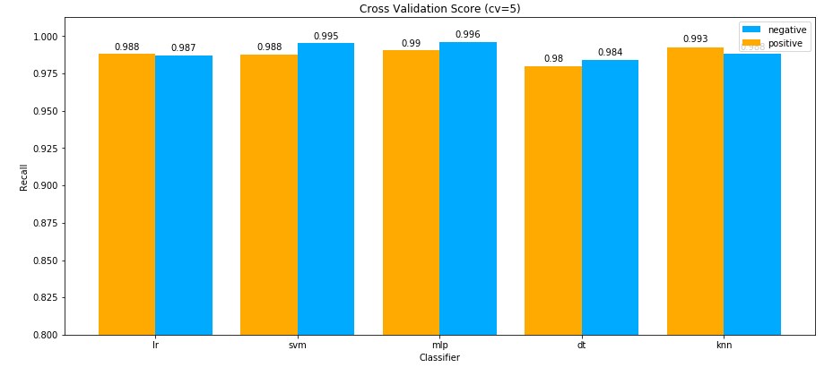
OVERVIEW
Segmentation Dataset
Imbalanced Ratio
1 : 6
Attributes
17
Observations
2308
Spambase Dataset
Credit Card Fraud Dataset
Imbalanced Ratio
2 : 3
Imbalanced Ratio
1 : 57
Attributes
58
Attributes
30
Observations
4601
Observations
284807

Slide 10
Documents and Code:
http://github.com/zkgz/skripsi

Slide 11


Uniform KNN
$$x_{2}$$
k = 3
= 0
= 3
=
pred
$$x_{1}$$

Slide 12
Weighted KNN 1
$$x_{2}$$
k = 5
=
=
$$x_{1}$$

Slide 13
Weighted KNN 1
$$x_{2}$$
k = 5
=
2
=
3
$$x_{1}$$

Slide 14
Weighted KNN 1
$$x_{2}$$
k = 5
=
=
=
pred
$$x_{1}$$

Slide 15


Weighted KNN 2
$$x_{2}$$
k = 3
=
$$\frac{1}{6}$$
=
$$\frac{2}{14}$$
=
pred
$$x_{1}$$

